Slide 1

https://github.com/shawnewallace/tdd-workshop

Slide 2
Test Driven Design

Slide 3
Agenda
(60 min) First session presentation
Introduction
The Case for TDD
Types of Testing
Example
(120 min) Pairing session. 30-minute sessions executing any of several code katas.
LUNCH BREAK
(60 min) Afternoon session presentation
Design for testability
Mocking
How to get started on my project
(120 min) Pairing session, Legacy refactor.

Slide 4
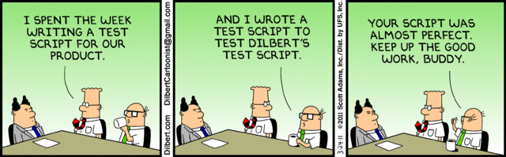
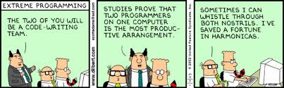
Agenda
Morning
Introduction
The Case for TDD
Types of Testing
Live Coding Example
Lab 1 - TDD Kata
LUNCH
Afternoon
Design for Testability
SOLID Principles
Lab 2 - Refactoring Exercise
Brownfield Development - adding TDD to existing project
Lab 3 - Legacy Refactor

Slide 5
Introduction

Slide 6
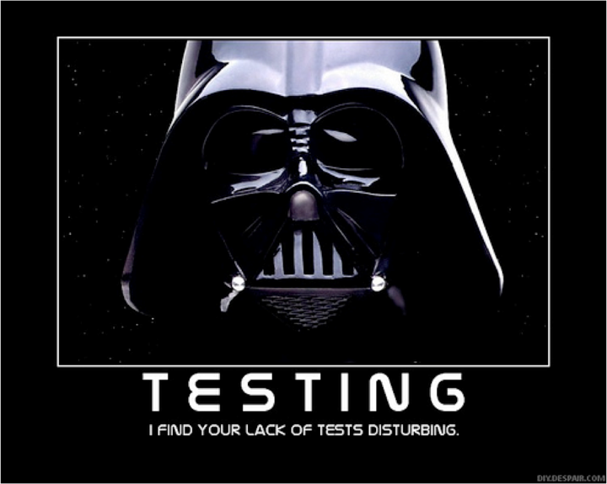

Slide 7
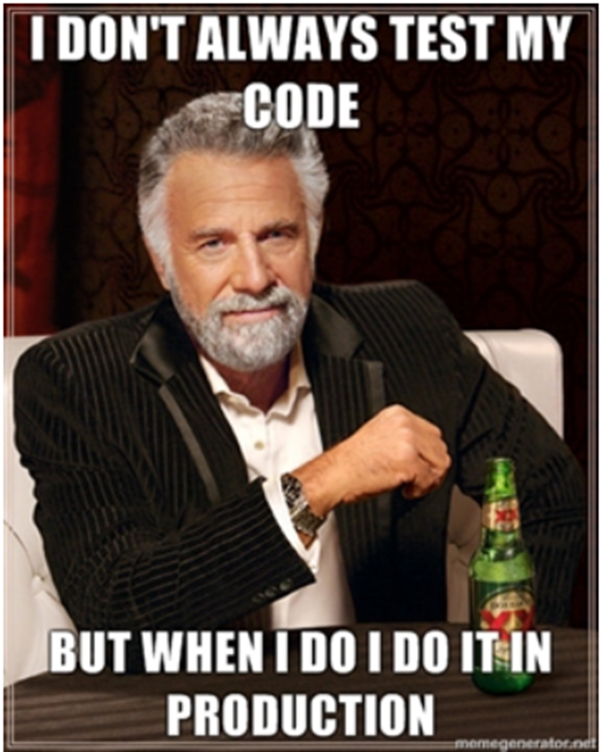

Slide 8

What it is
A Software Development Practice

Slide 9
What it is
Benefits
Productivity
Emergent Design
Better Code
Reduced Gold-Plating
Regression Test Suite

Slide 10
What it’s not
A panacea
Done wrong, it’s still wrong

Slide 11
What it’s not
Shortcomings
Can be difficult
Management support is crucial
Self-test paradigm
Overhead
Hard to get meaningful coverage in legacy systems

Slide 12
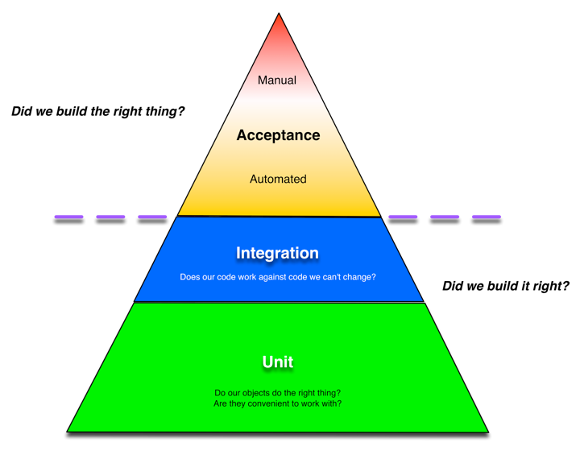
Types of Testing

Slide 13
Studies
Notes:
How does TDD help?

Slide 14
Relative cost of defect resolution
“fixing a production bug costs 100x more than fixing a bug at design time, and over 15x more than fixing a bug at implementation time.”
https://www.researchgate.net/publication/255965523_Integrating_Software_Assurance_into_the_Software_Development_Life_Cycle_SDLC

Slide 15
The Effects of TDD
It is common for initial project build-outs to take up to 30% longer with TDD
TDD Reduces production bug density 40%-80%
https://www.researchgate.net/publication/255965523_Integrating_Software_Assurance_into_the_Software_Development_Life_Cycle_SDLC

Slide 18
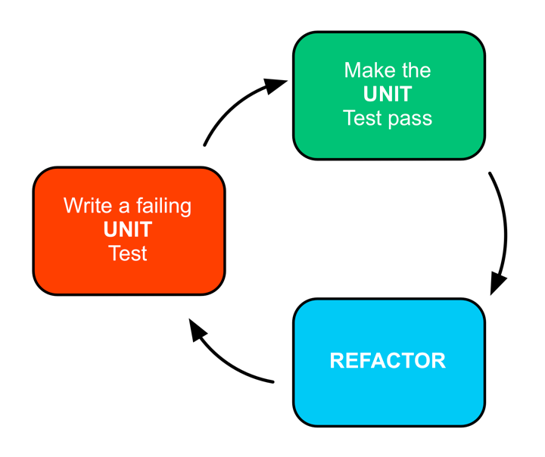
Test Driven Development

Slide 19

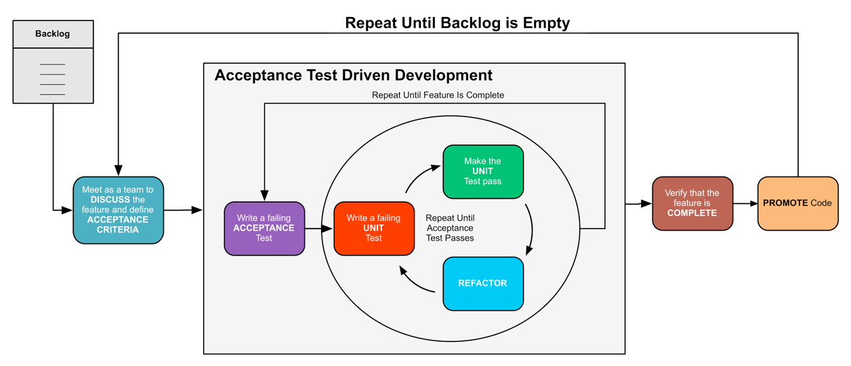
Workflow
Notes:
TDD is part of a bigger picture.

Slide 20
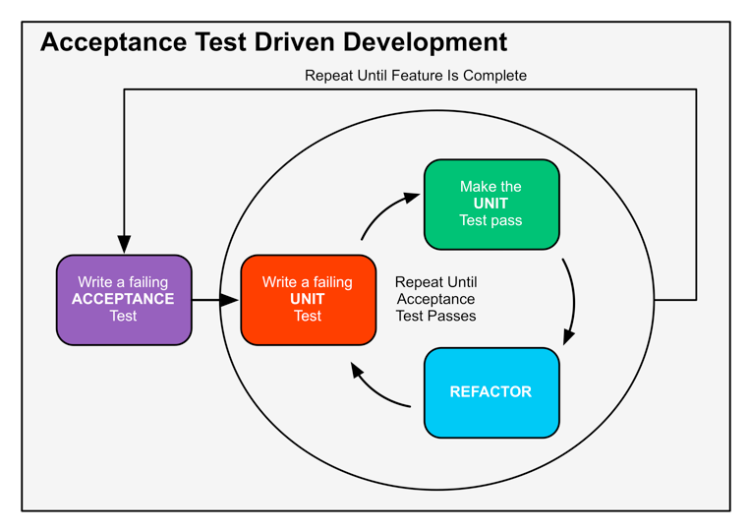
ATDD

Slide 21
TDD Flow
Notes:
1) Write a failing test for new functionality
2) Write just enough code to pass the test
3) Optimize, clean-up WITHOUT adding new functionality

Slide 22
The Three Rules of TDD
You are not allowed to write any production code unless it is to make a failing unit test pass.
You are not allowed to write any more of a unit test than is sufficient to fail; and compilation failures are failures.
You are not allowed to write any more production code than is sufficient to pass the one failing unit test.
http://butunclebob.com/ArticleS.UncleBob.TheThreeRulesOfTdd

Slide 23
How to Decide
Not really qualified until you do it and are good at it.
It has to work for your project and your team, it might not.

Slide 24

Greenfield Development
a project that lacks any constraints imposed by prior work

Slide 25
How do I start
Notes:
start somewhere

Slide 26
TDD Flow
Notes:
1) Write a failing test for new functionality
2) Write just enough code to pass the test
3) Optimize, clean-up WITHOUT adding new functionality

Slide 27
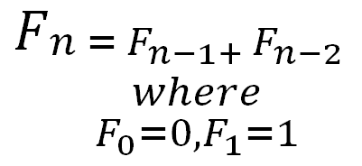
Workflow
Fibonacci Numbers

Slide 28
Red

Slide 29
Green

Slide 30
Refactor

Slide 31

Refactor without Fear

Slide 32
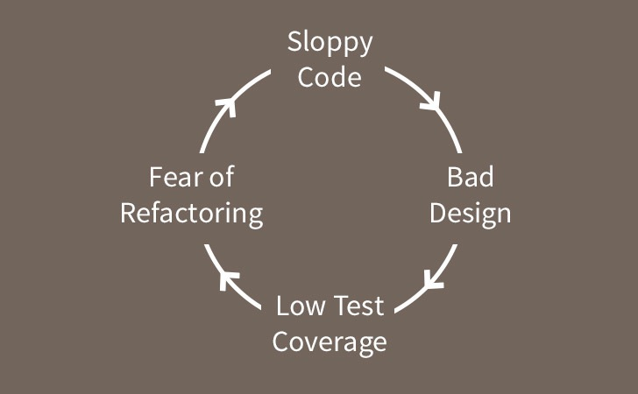

Slide 33
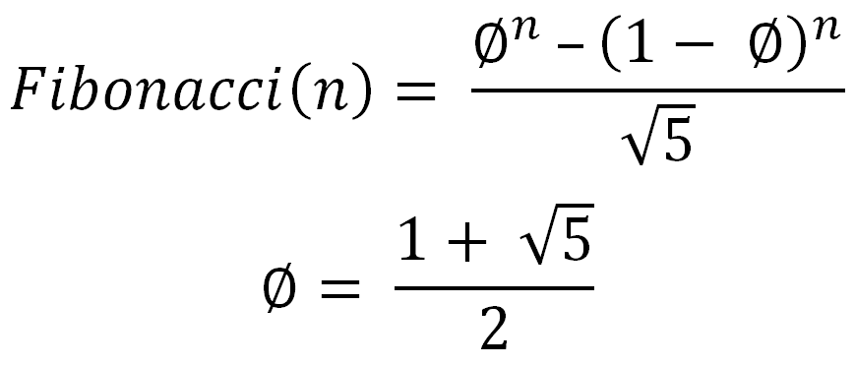
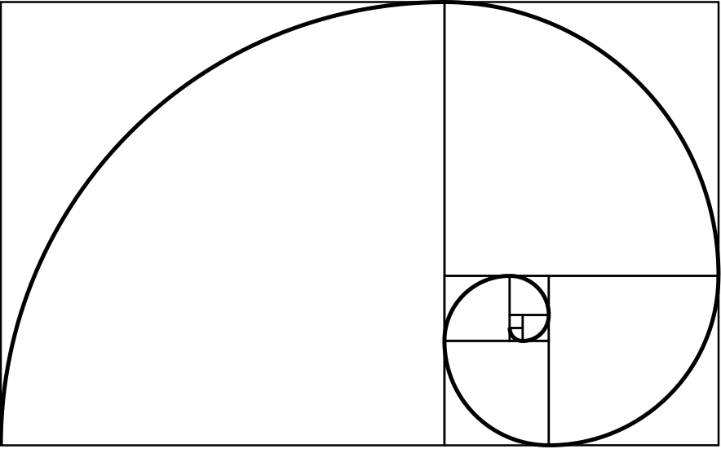
Notes:
Phi - the golden ratio

Slide 34
<lab 1>

Slide 35
Work in Pairs
<lab 1>

Slide 36
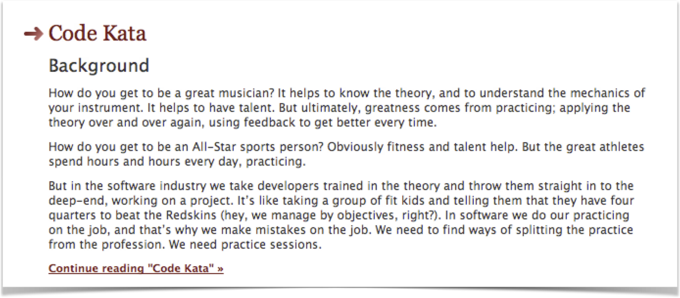
The Code Kata
<lab 1>
http://codekata.pragprog.com/

Slide 37
The Code Kata
<lab 1>
FizzBuzz
Bowling Game
Leap Year Calculator
Tennis Match
Roman Numeral Converter
Urinal Kata
Notes:
DO THE CODE KATAS NOW

Slide 38
https://github.com/shawnewallace/tdd-workshop

Slide 39
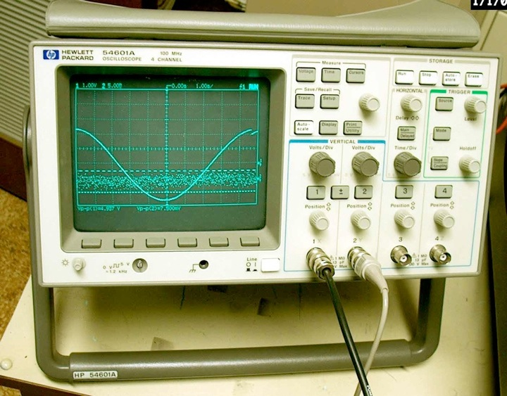
Design for Testability
Notes:
Want to take some time to talk about designing your applications and components to be testable.

Slide 40

"Debugging is twice as hard as writing the code in the first place. Therefore, if you write the code as cleverly as possible, you are, by definition, not smart enough to debug it."
--Brian Kernighan
Notes:
Reminds me of a quote
But we have some boundaries

Slide 41
Object Oriented Principles

Slide 42
Coupling and Cohesion
Tight vs. Loose Coupling
Interdependency
Coordination
Information Flow
High vs. Low Cohesion
Robustness
Reliability
Reusability
Notes:
cohesion is a measure of how strongly-related or focused the responsibilities of a single module are. As applied to object-oriented programming, if the methods that serve the given class tend to be similar in many aspects, then the class is said to have high cohesion. In a highly-cohesive system, code readability and the likelihood of reuse is increased, while complexity is kept manageable.
Cohesion is decreased if:
The functionalities embedded in a class, accessed through its methods, have little in common.
Methods carry out many varied activities, often using coarsely-grained or unrelated sets of data.
Disadvantages of low cohesion (or “weak cohesion”) are:
Increased difficulty in understanding modules.
Increased difficulty in maintaining a system, because logical changes in the domain affect multiple modules, and because changes in one module require changes in related modules.
Increased difficulty in reusing a module because most applications won’t need the random set of operations provided by a module.

Slide 43
We want LOOSE COUPLING
and
HIGH COHESION

Slide 44
Object Oriented Principles
Single Responsibility Principle
Open/closed Principle
Liskov Substitution Principle
Interface Segregation Principle
Dependency Inversion Principle
Notes:
SRP
Single responsibility principle
the notion that an object should have only a single responsibility.
OCP
Open/closed principle
the notion that “software entities … should be open for extension, but closed for modification”.
LSP
Liskov substitution principle
the notion that “objects in a program should be replaceable with instances of their subtypes without altering the correctness of that program”. See also design by contract.
ISP
Interface segregation principle
the notion that “many client specific interfaces are better than one general purpose interface.”[5]
DIP
Dependency inversion principle
the notion that one should “Depend upon Abstractions. Do not depend upon concretions.”[5]
Dependency injection is one method of following this principle.

Slide 45
Object Oriented Principles
Single Responsibility Principle
Open/closed Principle
Liskov Substitution Principle
Interface Segregation Principle
Dependency Inversion Principle
Notes:
SRP
Single responsibility principle
the notion that an object should have only a single responsibility.
OCP
Open/closed principle
the notion that “software entities … should be open for extension, but closed for modification”.
LSP
Liskov substitution principle
the notion that “objects in a program should be replaceable with instances of their subtypes without altering the correctness of that program”. See also design by contract.
ISP
Interface segregation principle
the notion that “many client specific interfaces are better than one general purpose interface.”[5]
DIP
Dependency inversion principle
the notion that one should “Depend upon Abstractions. Do not depend upon concretions.”[5]
Dependency injection is one method of following this principle.

Slide 46
Object Oriented Principles
Single Responsibility Principle
Open/closed Principle
Liskov Substitution Principle
Interface Segregation Principle
Dependency Inversion Principle
Notes:
SRP
Single responsibility principle
the notion that an object should have only a single responsibility.
OCP
Open/closed principle
the notion that “software entities … should be open for extension, but closed for modification”.
LSP
Liskov substitution principle
the notion that “objects in a program should be replaceable with instances of their subtypes without altering the correctness of that program”. See also design by contract.
ISP
Interface segregation principle
the notion that “many client specific interfaces are better than one general purpose interface.”[5]
DIP
Dependency inversion principle
the notion that one should “Depend upon Abstractions. Do not depend upon concretions.”[5]
Dependency injection is one method of following this principle.

Slide 47
Object Oriented Principles
Single Responsibility Principle
Open/closed Principle
Liskov Substitution Principle
Interface Segregation Principle
Dependency Inversion Principle
Notes:
SRP
Single responsibility principle
the notion that an object should have only a single responsibility.
OCP
Open/closed principle
the notion that “software entities … should be open for extension, but closed for modification”.
LSP
Liskov substitution principle
the notion that “objects in a program should be replaceable with instances of their subtypes without altering the correctness of that program”. See also design by contract.
ISP
Interface segregation principle
the notion that “many client specific interfaces are better than one general purpose interface.”[5]
DIP
Dependency inversion principle
the notion that one should “Depend upon Abstractions. Do not depend upon concretions.”[5]
Dependency injection is one method of following this principle.

Slide 48
Object Oriented Principles
Single Responsibility Principle
Open/closed Principle
Liskov Substitution Principle
Interface Segregation Principle
Dependency Inversion Principle
Notes:
SRP
Single responsibility principle
the notion that an object should have only a single responsibility.
OCP
Open/closed principle
the notion that “software entities … should be open for extension, but closed for modification”.
LSP
Liskov substitution principle
the notion that “objects in a program should be replaceable with instances of their subtypes without altering the correctness of that program”. See also design by contract.
ISP
Interface segregation principle
the notion that “many client specific interfaces are better than one general purpose interface.”[5]
DIP
Dependency inversion principle
the notion that one should “Depend upon Abstractions. Do not depend upon concretions.”[5]
Dependency injection is one method of following this principle.

Slide 49
Interface Segregation Principle

Slide 50
Code to interfaces, depending on your languages

Slide 51
Object Oriented Principles
Single Responsibility Principle
Open/closed Principle
Liskov Substitution Principle
Interface Segregation Principle
Dependency Inversion Principle
Notes:
SRP
Single responsibility principle
the notion that an object should have only a single responsibility.
OCP
Open/closed principle
the notion that “software entities … should be open for extension, but closed for modification”.
LSP
Liskov substitution principle
the notion that “objects in a program should be replaceable with instances of their subtypes without altering the correctness of that program”. See also design by contract.
ISP
Interface segregation principle
the notion that “many client specific interfaces are better than one general purpose interface.”[5]
DIP
Dependency inversion principle
the notion that one should “Depend upon Abstractions. Do not depend upon concretions.”[5]
Dependency injection is one method of following this principle.

Slide 52
Dependency Inversion Principle
“Depend on abstractions, not ‘concretions’”

Slide 53
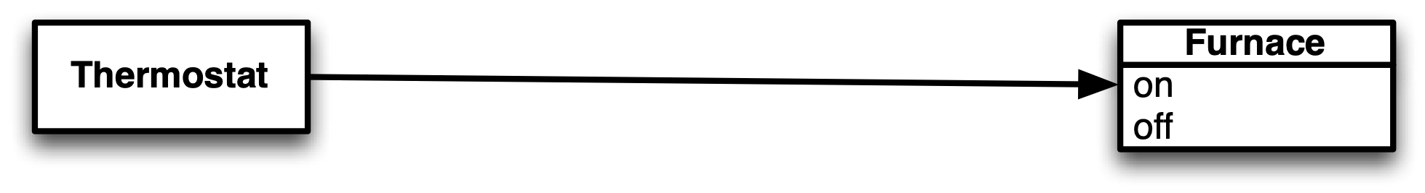

Slide 54
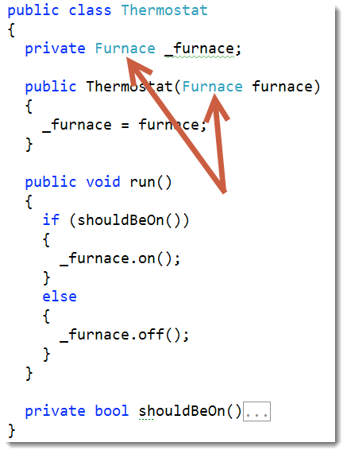

Slide 55
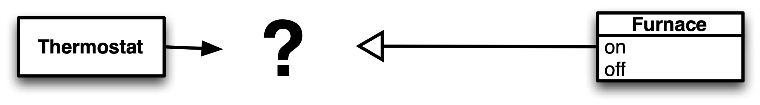

Slide 56
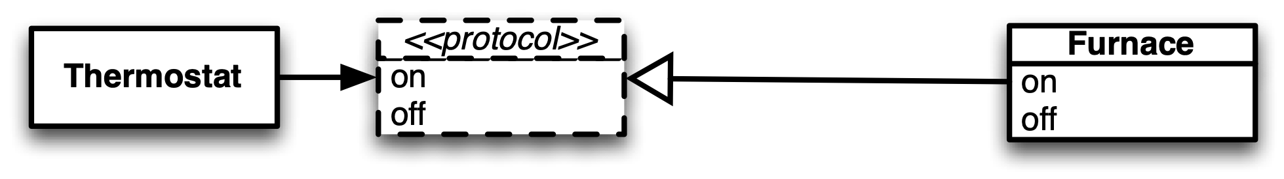

Slide 57
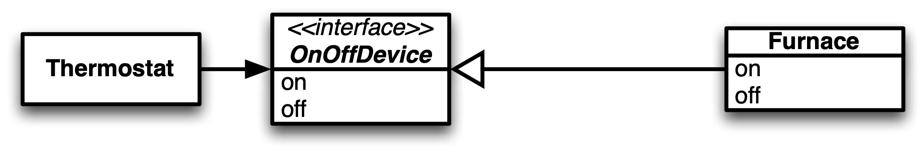

Slide 58
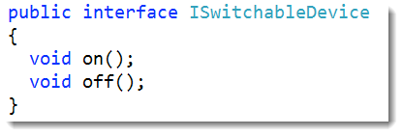
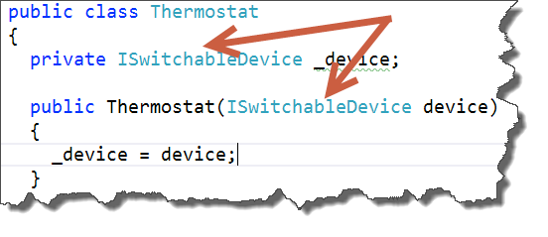

Slide 59
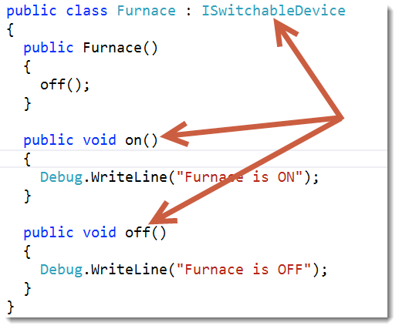

Slide 60
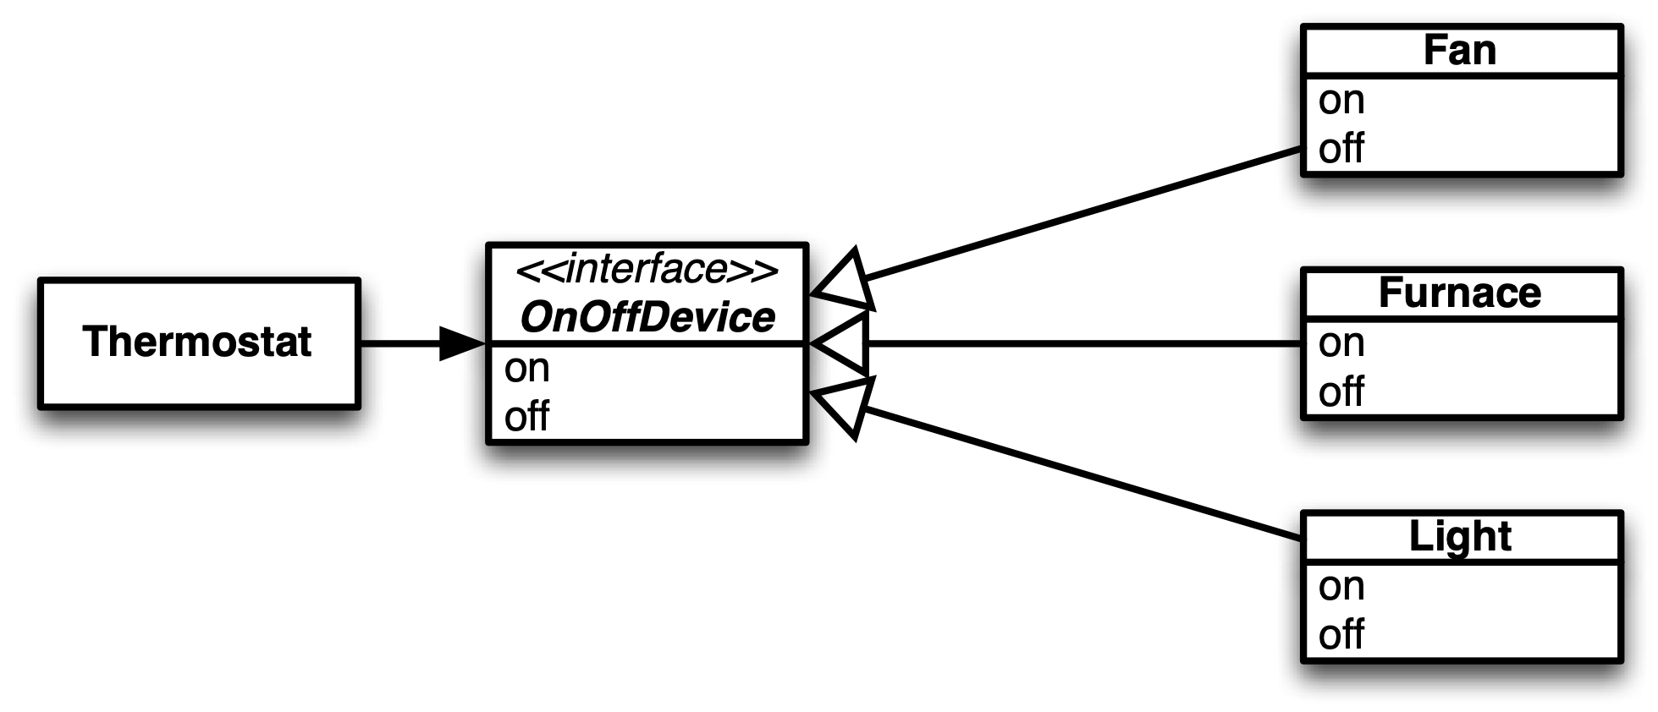

Slide 61
<lab - refactor>
https://github.com/shawnewallace/tdd-workshop

Slide 62

Brownfield Development

Slide 63
Can we benefit?
We can improve design going forward
The goal is writing working code/providing value

Slide 64
How to start
Test KEY use cases
Test defects
Test new features

Slide 65
Refactor
Discover the intent
Isolate Dependencies (Inversion of Control)
Re-design for testability
Introduce helpful abstractions
Address anti-patterns

Slide 66
Refactor
Key anti-patterns
Magic Numbers
Long Methods
Long Class
Poor Naming
Empty Catches
Similar Code
Unclear Tests
Large Tests

Slide 67
<lab - >
https://github.com/shawnewallace/tdd-workshop

Slide 68

Shawn Wallace
shawn.wallace@centricconsulting.com
http://about.me/shawnwallace
@ShawnWallace
614-270-1600

